Slide 1
The Independence and Impartiality of Arbitrators and Experts
Practice of International Arbitration
University of Würzburg
14 October 2016
Invalidenstrasse 7/9, 1030 Vienna, Austria | Phone: +43 1 718 4488 - 0 | E-Mail: office@aschauer.online | Web: www.aschauer.online

Slide 2
I. Introduction
The standing of judges as opposed to the standing of arbitrators
Judges are irremovable from office
Judges have a fixed income
Judges have (usually) no other occupations
Arbitrators are appointed on a case-by-case basis
Arbitrators are remunerated on a case-by-case basis
Arbitrators are also party representatives / partners of international law firms / university professors

Slide 3
I. Introduction
The authority of arbitrators as opposed to the authority of judges
No appeal against the decision of the arbitral tribunal
Discretion of the arbitral tribunal to decide procedural matters (Art 19 ICC Rules; Art. 7.8 of the CAM-CCBC Arbitration Rules: „The Arbitral Tribunal will adopt the necessary and convenient measures for the appropriate conduct of the proceedings, observing the right to fully defend oneself and the right to dispute the allegations of the other party, as well as the equal treatment of the parties.“)

Slide 4
I. Introduction
Conclusions:
It is not appropriate to apply standards that are effective for state court judges with regard to arbitrators
Arbitrators must be even „more independent and impartial“ than state court judges

Slide 5
II. Standards of independence and impartiality for arbitrators
Statutory standards
Sect. 12(2) UNCITRAL Model Law = Sect. 1036(2) German CPC: „An arbitrator may be challenged only if circumstances exist that give rise to justifiable doubts as to his impartiality or independence, or if he does not possess qualifications agreed to by the parties”
Nacimiento/Abt/Stein in Böckstiegel: “independence is understood as an objective criterion for the connection of the arbitrator to the parties and impartiality as a subjective criterion for the mental attitude of the arbitrator to the case to be decided”

Slide 6
II. Standards of independence and impartiality for arbitrators
Standards agreed by the Parties
Art. 11(1) ICC Arbitration Rules: „Every arbitrator must be and remain impartial and independent of the parties involved in the arbitration.“
Art. 13(5) ICC Arbitration Rules: „The sole arbitrator or the president of the arbitral tribunal shall be of a nationality other than those of the parties.“

Slide 7
II. Standards of independence and impartiality for arbitrators
Standards agreed by the Parties (continued)
Art. 5(2) CAM-CCBC Arbitration Rules: „5.2. A person cannot be appointed as an arbitrator if he or she: (a) Is a party to the dispute; (b) Has participated in the resolution of the dispute as legal representative for one of the parties before a judicial authority, testified as a witness, served as an expert or presented an opinion; (c) Is a spouse or relative, whether by blood or marriage, as an ancestor, descendent or collaterally, to the third degree, of one of the parties; (d) Is a spouse or relative, whether by blood or marriage, as an ancestor, descendent or collaterally, to the second-degree, of the attorney or representative of one of the parties; (e) Participates in a management or administrative body of a corporate entity that is a party to the litigation or is a shareholder or partner; (f) Is a personal friend or enemy of one of the parties; (g) Is a creditor or debtor of one of the parties or of his or her spouse or of relatives, whether ancestors, descendents or collaterally, to the third degree;

Slide 8
II. Standards of independence and impartiality for arbitrators
Standards agreed by the Parties
Art. 5(2) CAM-CCBC Arbitration Rules (continued): (h) Is a presumptive heir, legatee, employer or employee of one of the parties; (i) Receives gifts before or after the dispute begins, advises one of the parties regarding the subject matter of the case or provides funds to cover the expenses of the proceedings; (j) Has a direct or indirect interest in the decision of the dispute in favor of one of the parties; (k) Has served as a mediator or conciliator in the dispute before the commencement of arbitration, unless expressly agreed to by the parties; (l) Has an economic interest related to any of the parties or their lawyers, unless there is express agreement of all parties.”

Slide 9
II. Standards of independence and impartiality for arbitrators
Soft Law
2014 IBA Guidelines on Conflicts of Interest in International Arbitration
Reflect the understanding of the IBA Arbitration Committee as to the best current practice
Are not legal provisions and do not override any national law
Do not purport to be exhaustive
Non-Waivable Red List: no person can be his or her own judge, cannot be cured
Waivable Red List: serious, but can be waived by an express declaration
Orange List: still under a duty to disclose, but can be waived by implication (no objection)
Green List: no disclosure required

Slide 10
II. Standards of independence and impartiality for arbitrators
Soft Law
1987 IBA Rules of Ethics for International Arbitrators
“3.3 Any current direct or indirect business relationship between an arbitrator and a party, or with a person who is known to be a potentially important witness, will normally give rise to justifiable doubts as to a prospective arbitrator's impartiality or independence. […] Examples of indirect relationships are where a member of the prospective arbitrator's family, his firm, or any business partner has a business relationship with one of the parties.
3.4 Past business relationships will not operate as an absolute bar to acceptance of appointment, unless they are of such magnitude or nature as to be likely to affect a prospective arbitrator's judgment.
3.5 Continuous and substantial social or professional relationships between a prospective arbitrator and a party, or with a person who is known to be a potentially important witness in the arbitration, will normally give rise to justifiable doubts as to the impartiality or independence of a prospective arbitrator.”

Slide 11
II. Standards of independence and impartiality for arbitrators
Duty of Disclosure
Statutory Law
Agreed rules of arbitration
Soft law
No liability privilege

Slide 12
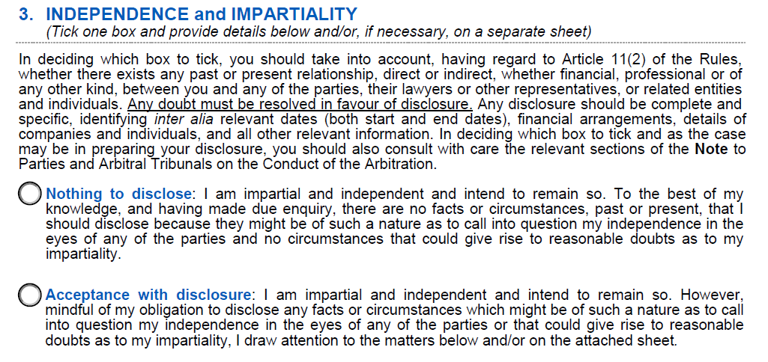
II. Standards of independence and impartiality for arbitrators
Example of disclosure

Slide 13
II. Standards of independence and impartiality for arbitrators
Different standards for party-appointed arbitrators?
The role of party appointed arbitrators as opposed to the role of the president
The law does not distinguish / the rules do not distinguish
Different standards at the beginning / towards the end of the arbitration?
Removal of the arbitrator at the beginning / towards the end of the arbitration
The law does not distinguish / the rules do not distinguish

Slide 14
III. Legal remedies to safeguard the independence and impartiality of arbitrators
Challenge of the arbitrator
Ad hoc arbitration: Sect. 13(2) UNCITRAL Model Law = Sect. 1037(2) German CPC: 14 days/2 weeks – decision of the arbitral tribunal (including the challenged arbitrator)
UNCITRAL arbitral proceedings: Art. 15 UNCITRAL Arbitration Rules: 15 days – decision of the appointing authority
Institutional arbitral proceedings:
Art 14 ICC Rules: 30 days – decision of the ICC Court of Arbitration
Art. 5(4) CAM-CCBC Arbitration Rules: 15 days – decision of Special Committee of 3 arbitrators appointed by the President of the CAM-CCBC

Slide 15
III. Legal remedies to safeguard the independence and impartiality of arbitrators
Review of the decision on the challenge by the state courts
Section 1037(3) German CPC: if the challenge is not successful, appeal to the Higher Regional Court („Oberlandesgericht“)
Section 589(2) Austrian CPC: if the challenge is not successful, appeal to the Supreme Court („Oberster Gerichtshof“)
If the appeal is also not successful, no further remedy in the country where the award was made

Slide 16
III. Legal remedies to safeguard the independence and impartiality of arbitrators
Setting aside of the award
(if the party becomes aware of the lack of independence and impartiality after the notification of the award)
EXAMPLE I: Swiss Federal Court, 7 September 2016, no. 4A_386/2015
23 April 2015: final award
8 July 2015: « l'un des trois conseils qui l'avaient assistée durant la procédure arbitrale a découvert un communiqué de presse, datant du 5 décembre 2014, par lequel le cabinet juridique et fiscal allemand A.________-A portait à la connaissance du public, sous le titre " Z.________ advised on e-mobility by A.________ ", qu'il avait conseillé la société de droit allemand Z.________ GmbH (ci-après: Z.________), à Berlin, autre société du Groupe Y.________, dans la mise en oeuvre d'un projet relatif à une application pour téléphones portables destinée aux conducteurs de voitures électriques. Selon la requérante, ce lien entre l'étude A.________ et une société appartenant au même groupe que celle qui avait déposé la requête d'arbitrage eût constitué un motif de récusation, respectivement de recours contre la sentence, si elle en avait appris l'existence pendente lite ou, du moins, avant l'expiration du délai de recours. Aussi justifie-t-il, à ses
yeux, la mise en oeuvre d'une procédure de révision.. »

Slide 17
III. Legal remedies to safeguard the independence and impartiality of arbitrators
EXAMPLE I continued: Swiss Federal Court, 7 September 2016, no. 4A_386/2015 (continued)
Defence of the arbitrator:
The law firm was not integrated, partners did not share revenues
He was not aware of the conflict
Decision of the Swiss Federal Court:
Sécurité du droit – legal certainty
In principle, the setting aside can be warrented even if the reason for the challenge was only found after the notication of the award
The IBA Rules can be used as a guideline to assess the gravity of the conflict
In actuality, the partners did not form one integrated office
The arbitrator was appointed by the ICC Court, not party-appointed
„les circonstances du cas concret, seules décisives, ne
sont de toute façon pas d'une gravité telle que le maintien de la sentence formant l'objet de la demande
de révision apparaîtrait incompatible avec le sentiment de la justice et de l'équité. »

Slide 18
III. Legal remedies to safeguard independence and impartiality of arbitrators
Refusal to recognize and enforce the award
Art. V(1)(d) New York Convention: „The composition of the arbitral authority or the arbitral procedure was not in accordance with the agreement of the parties”
Art. V(2)(b) New York Convention: “The recognition or enforcement of the award would be contrary to the public policy of that country”

Slide 19
IV. Further examples
EXAMPLE II: Supreme Court of Austria, 18 ONc 1/14p and 18 ONc 2/14k
EXAMPLE III: Supreme Court of Austria, 18 ONc 3/15h

Slide 20
VI. Independence and Impartiality of Experts
Party appointed experts vs. Tribunal appointed experts
Challenge of tribunal-appointed experts
Duty of party-appointed experts to disclose links with “their parties”
Evaluation of evidence
Example IV: The university professor

